Slide 1
Prototyping Project | Functional balanced endeffector Team Mehmet koc – Hong Phuoc Nguyen Nguyen

Slide 2
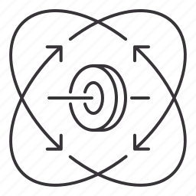

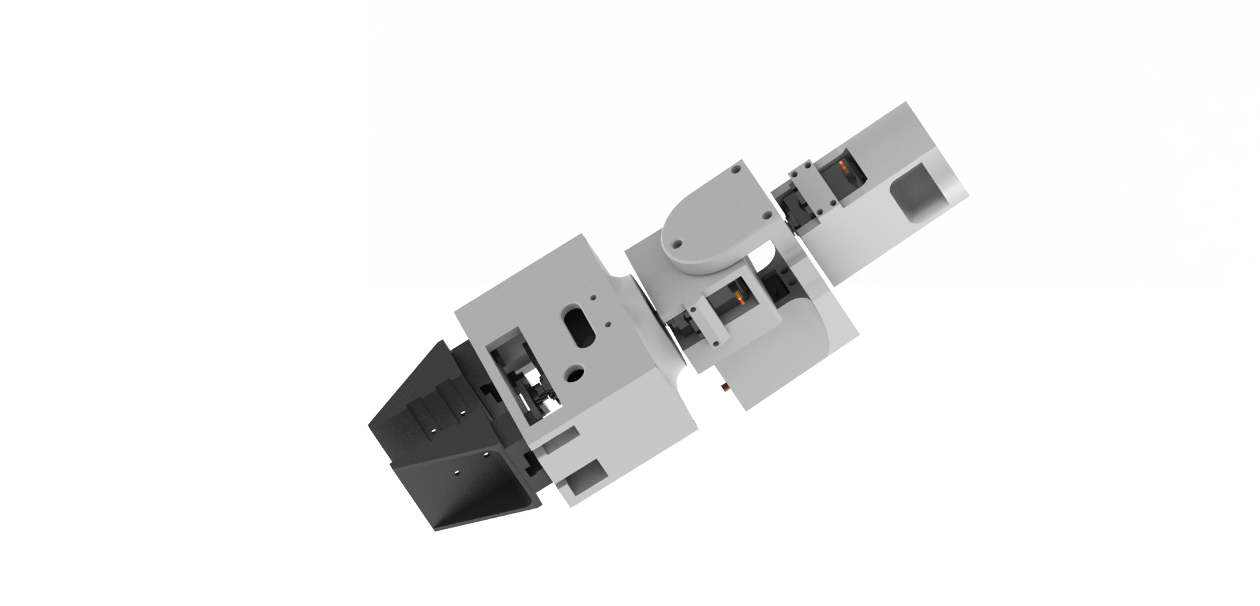
Project Introduction
Motivation
Balancing functionality of the gripper/end-effector mechanism
Variable application areas on the robotic industry
Different functional end-effectors are available
ZYZ Rotational joints can reach all directions
Solution for the „Singularity“
Cost-efficient solution for functional end-effectors
Increase the DOF of the simple robotic arm
https://www.iconfinder.com/

Slide 3
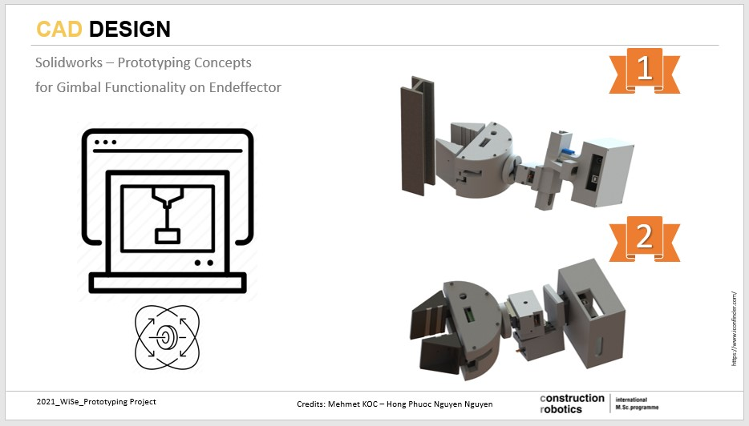
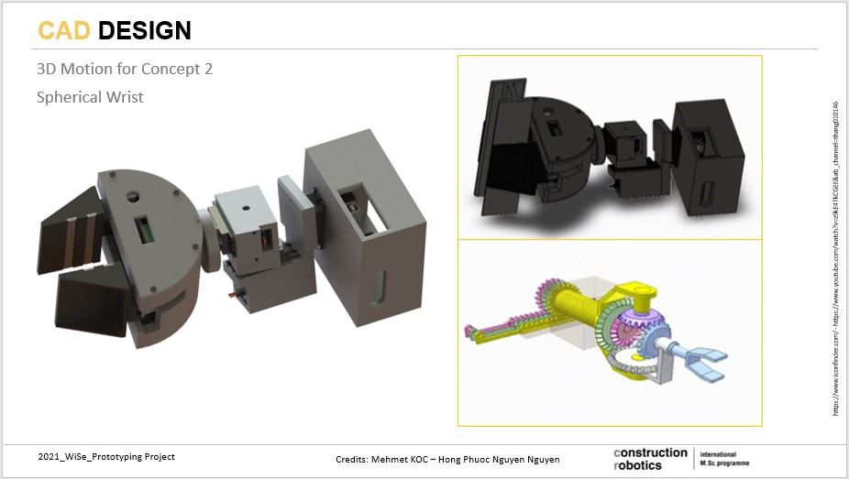
CAD Design
Solidworks – Outlook on the Old Prototyping Designs

Slide 4
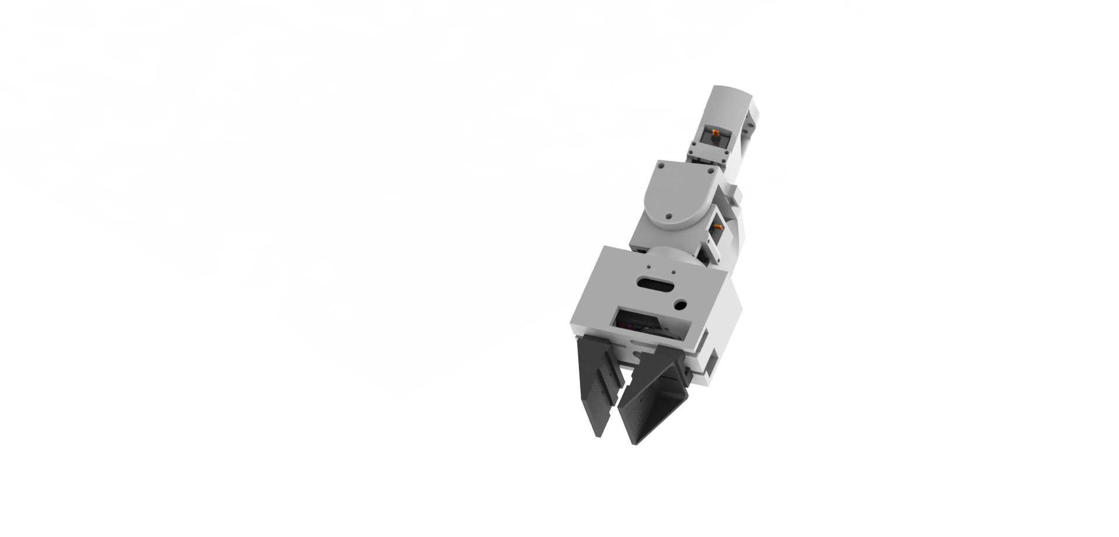
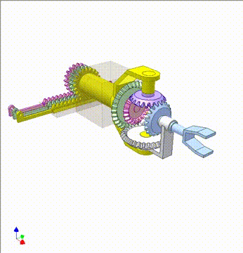
CAD Design
Update on the Prototyping Design
https://www.iconfinder.com/ - https://www.youtube.com/watch?v=z9kE4TkCGEE&ab_channel=thang010146

Slide 5
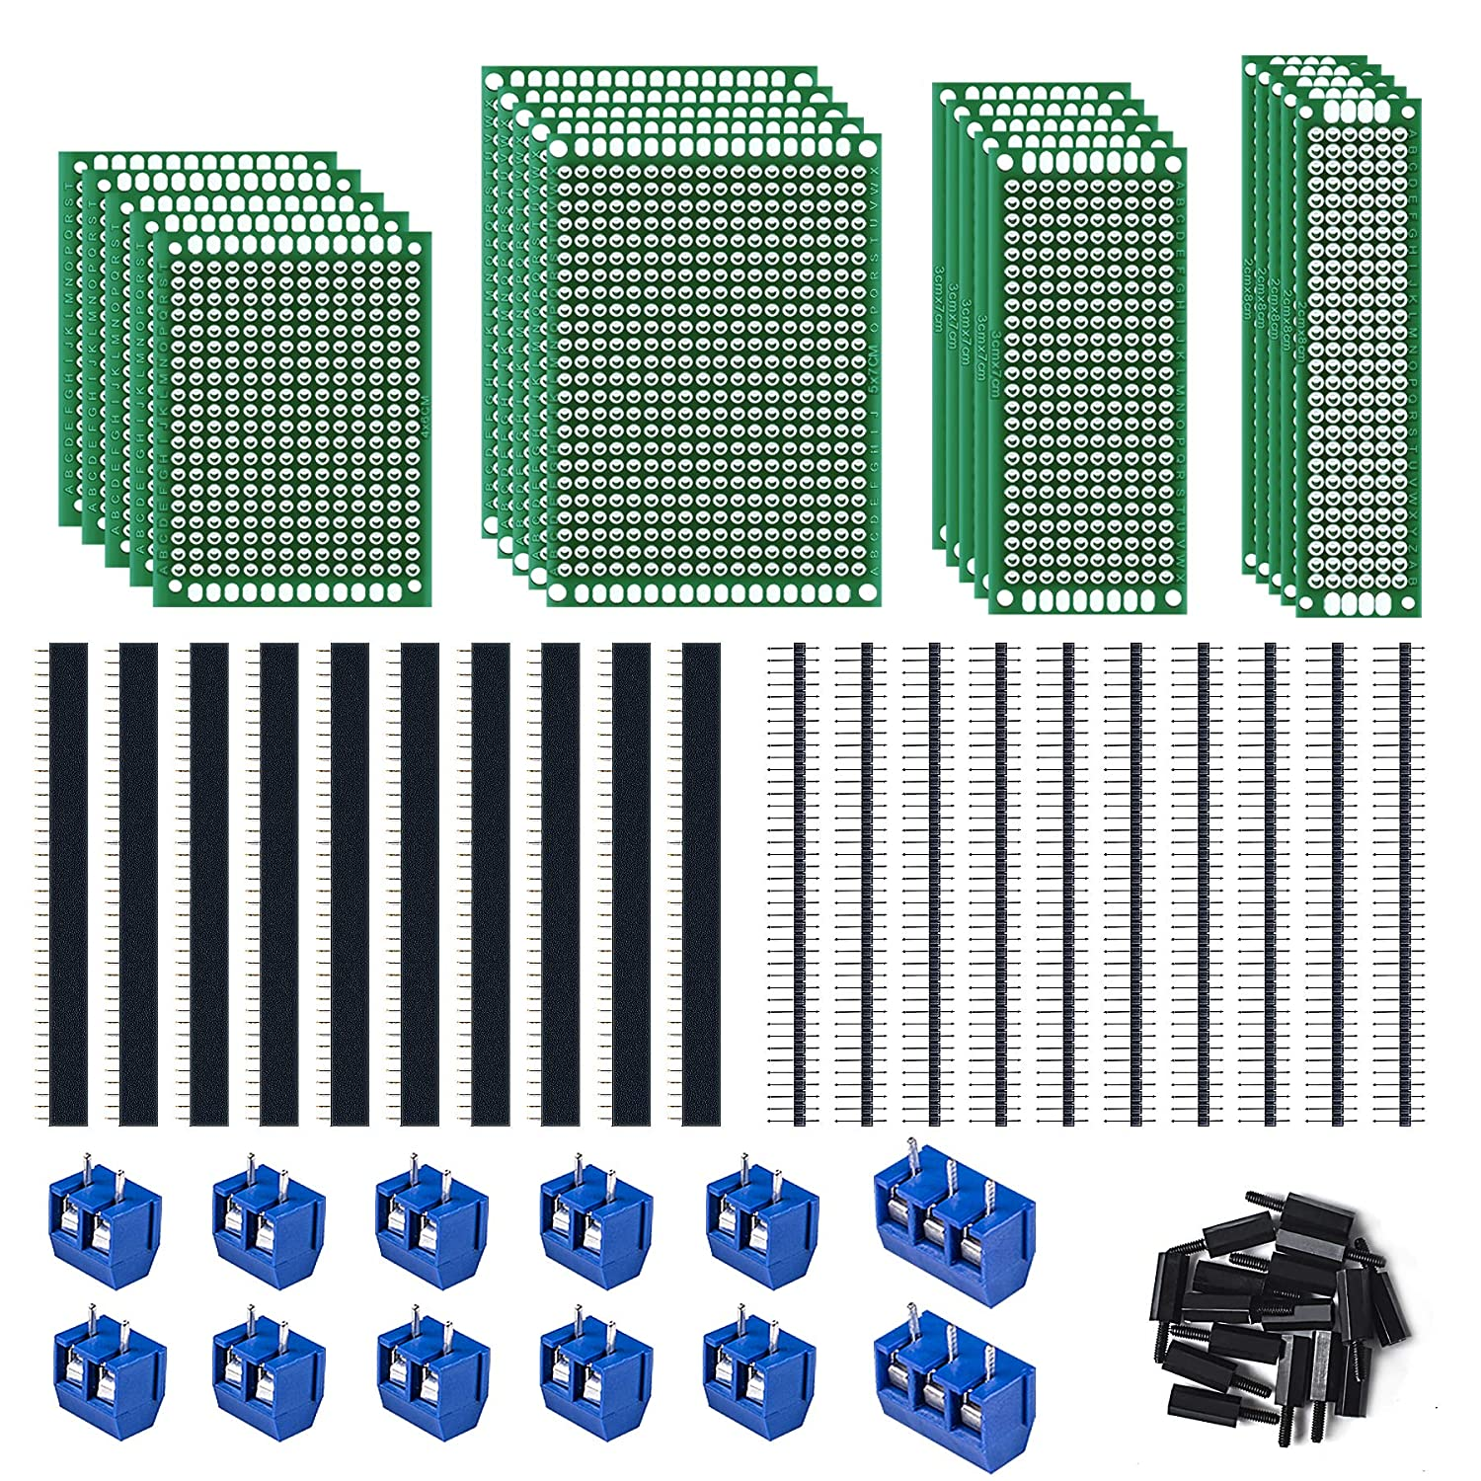
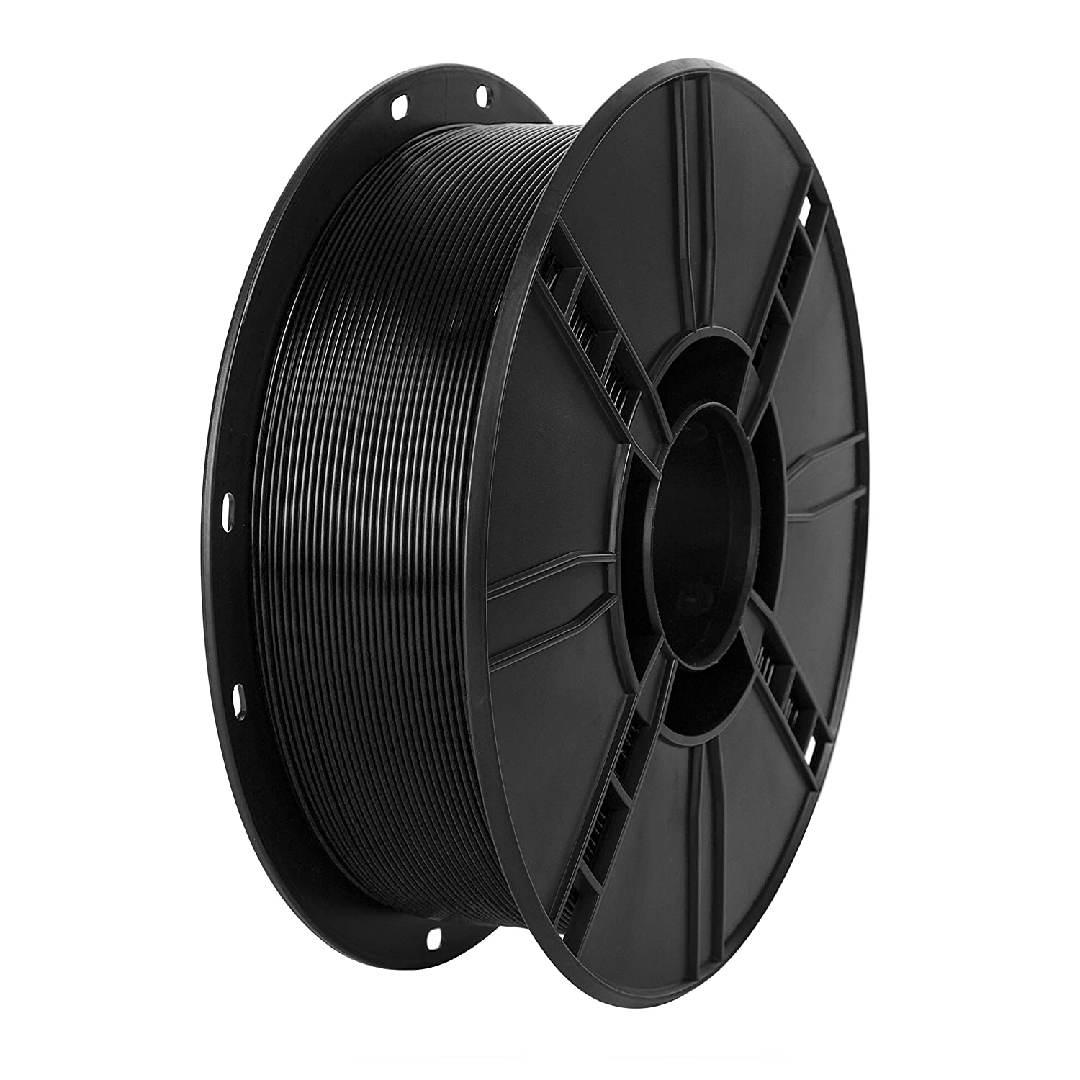
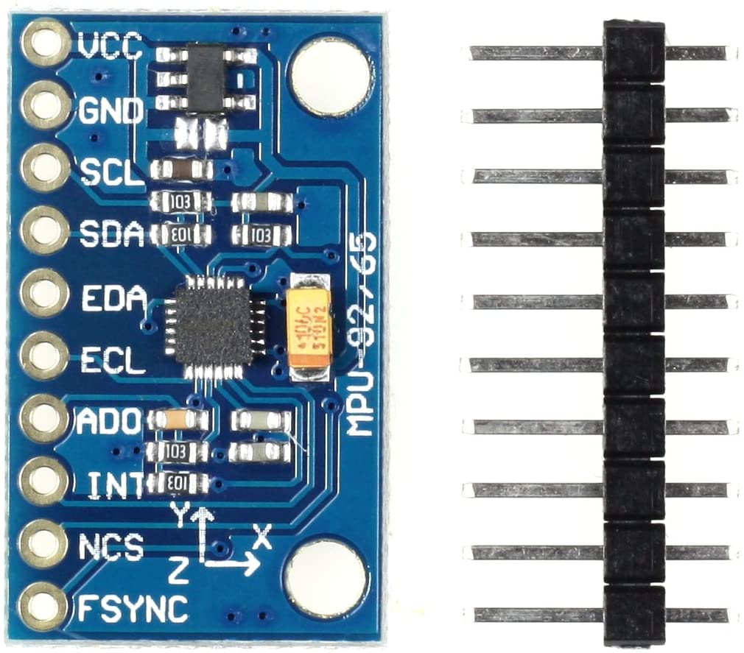
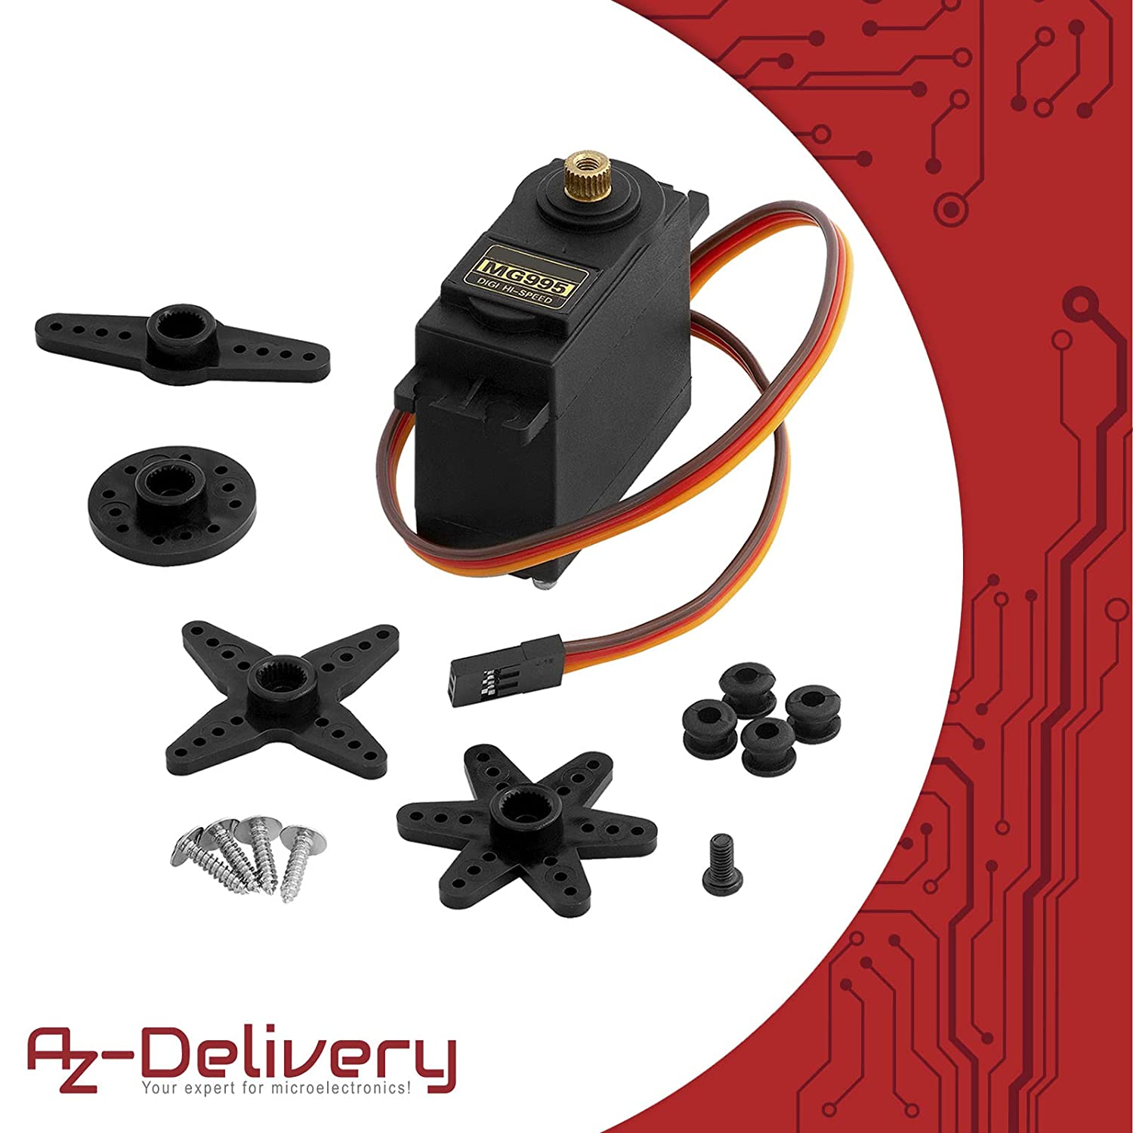
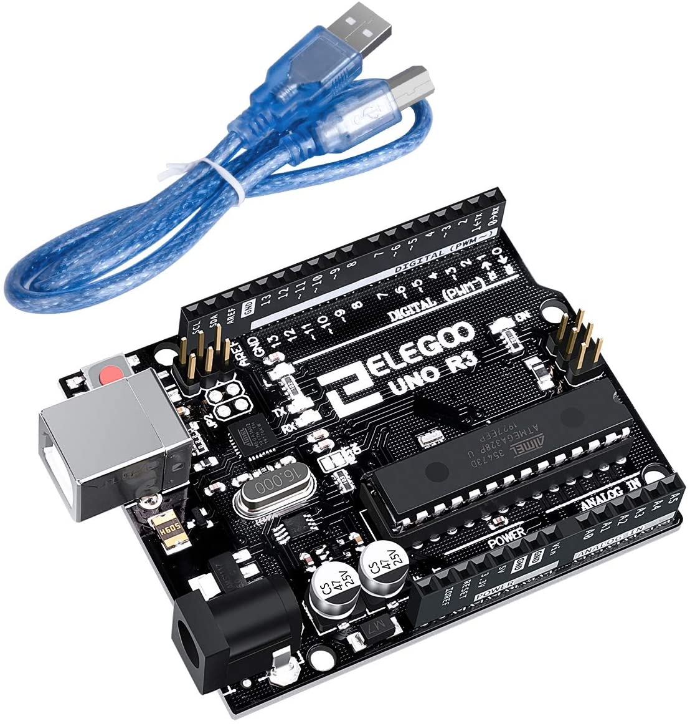
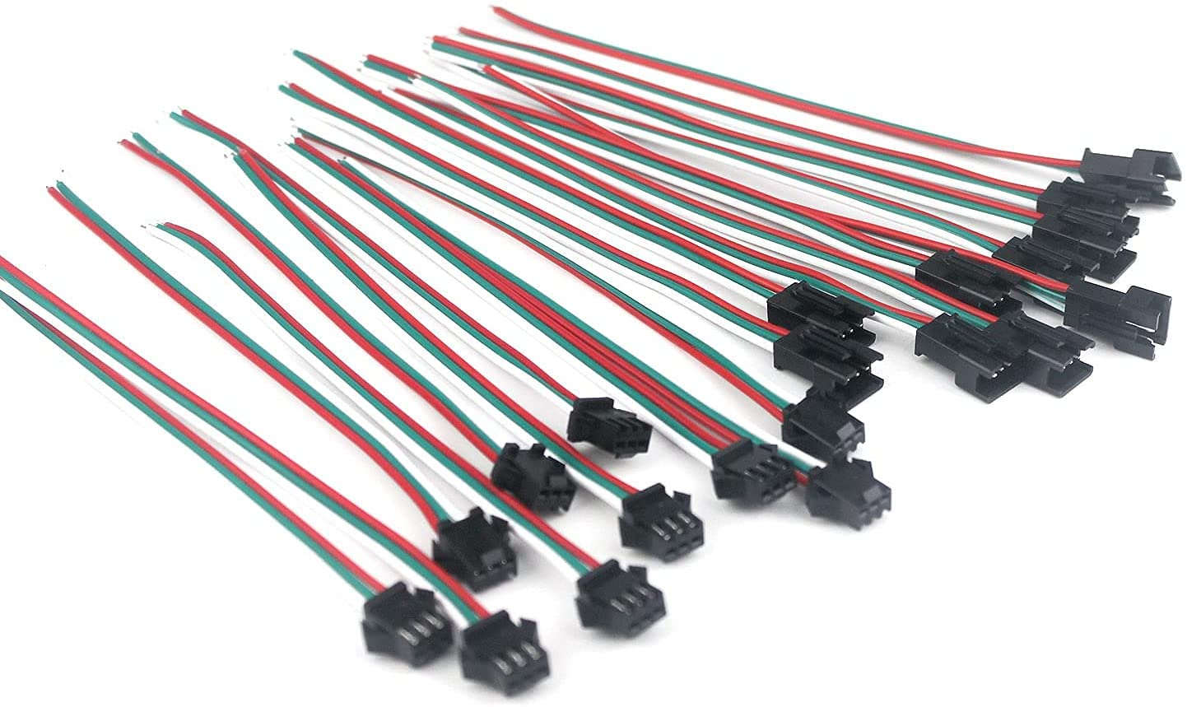
Prototypıng PHASE
Hardware Components
https://www.amazon.de/-/en/ref=nav_logo

Slide 6
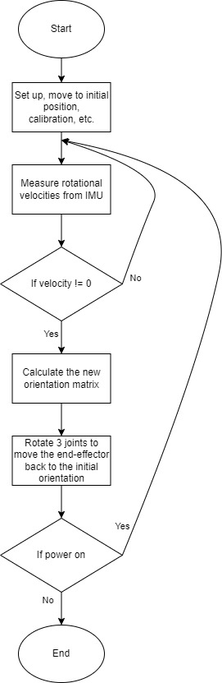
Prototypıng PHASE
Programming the Balancing Algorithm

Slide 7


Slide 8
Future Improvements
Difficulties
Improvements
Hardware:
Mechanical and electrical parts are not stable due to the production method
Motors have limit (can only rotate about 180 degree)
The custom board is better, but not best
Software:
Only measure indirect the orientation
Still cannot perfectly handle the singularity
Hardware:
Replace plastic by metal
Replace old motors by better ones
Change the electrical circuit to PCB board
Change the gripper mechanism to rack and pinion
Modularization for easy assembly
Software
Measure the orientation directly
Find solutions for the singularity
Find better calibration and noise elimination

Slide 9
functıonal balanced end-effector
THANK YOU!
ANY QUESTIONS?

